Slide 1



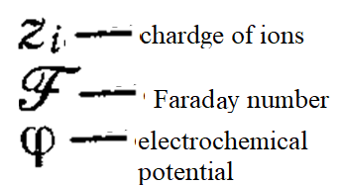
Lecture 9. Adsorption of electrolytes. EDL formation. Theory of EDL. Helmholtz, Gouy-Chapman theories). Stern theory of EDL.
Electric double layer (EDL) formation occurs due to ion adsorption.
Adilbekova A.O

Slide 2





Slide 3
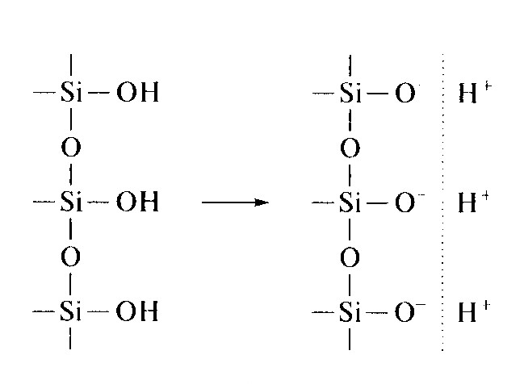
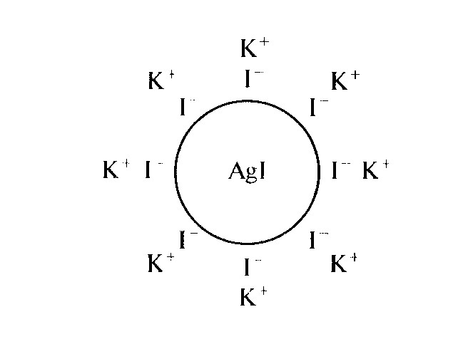
There are two mechanisms of EDL (electric double layer) formation: ion adsorption and surface dissociation:

Slide 4
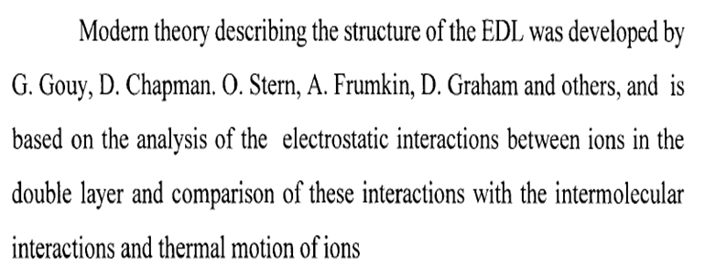
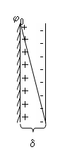
1.EDL theories : Helmholtz, 1879
Plane capacity

Slide 5
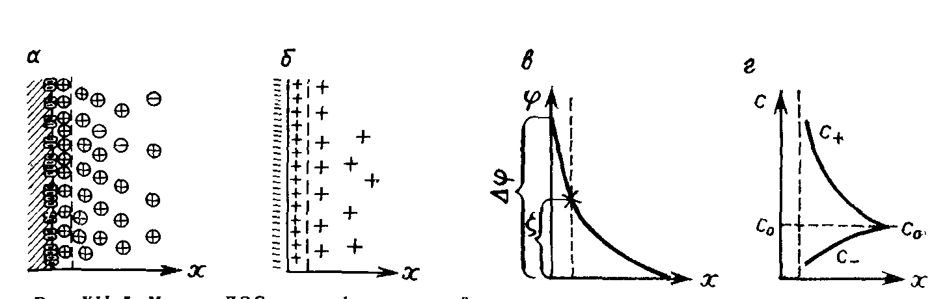
Gouy-Chapman

Slide 6
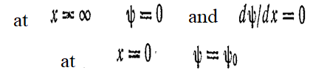
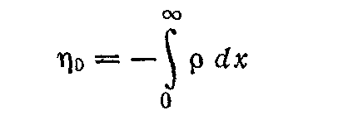
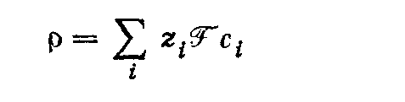
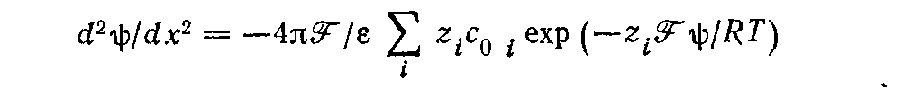
Gouy-Chapman,

Slide 7
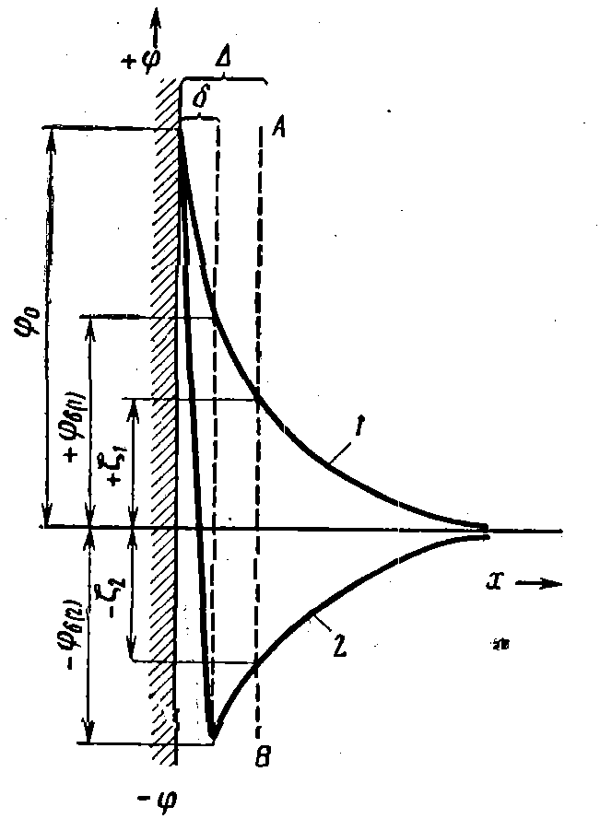
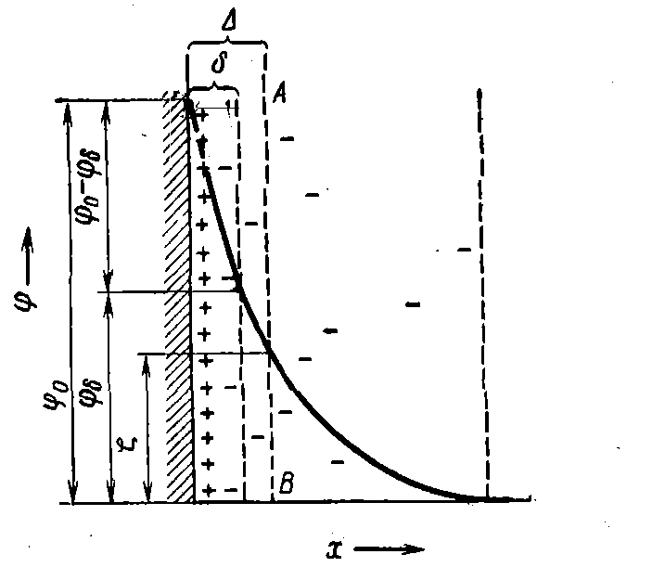
Stern

Slide 8
ϕ_{х} = ϕ_{δ} е ^{– æ (х-δ)} (2)
ϕ_{х} = ϕ_{δ} е ^{– æ х} (3)
æ² = 1 /λ² = 2 F² I /(ε ε₀ R T) (4)
I= ½ ∑(с_{0i} ⋅z_{i2});
æ – a value which is irreversible proportional to diffusion layer, λ - thickness of diffusion layer ,
I – ionic strength, ε–dielectrical permittivity ; ε₀ – electric constant, 8,85⋅10⁻¹² F/m.

Slide 9
ϕ_{х}=(4RT/zF)γе^{-æх} (5)
where
(6)

Slide 10
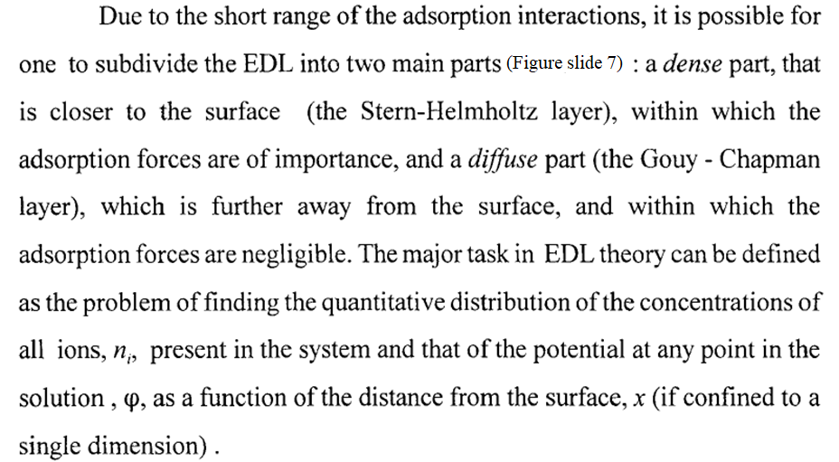

Slide 11
Questions?
Thank you for your attention!
Adilbekova A.O

